Slide 1
Disaster Preparedness & Business Continuity
Before, During and After a Disaster

Slide 2




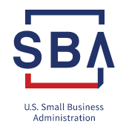
About Us
Member of Florida SBDC Network
Established in 1976
Nationally Accredited
Funded in part by the U.S. SBA
Regional Office University of Central Florida and Hosted by Daytona State College (Volusia County)

Slide 3
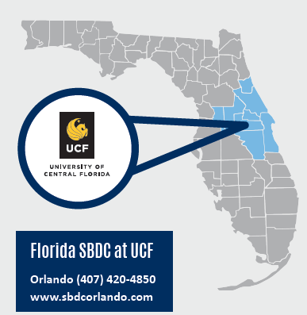
Helping Businesses Grow & Succeed
Hosted by
Florida SBDC at DSC
386-506-4723
www.FloridaSBDC.org

Slide 4
Florida SBDC at UCF- Osceola County
Our Services
Business Consulting | One-on-One
Training Seminars & Special Programs
Business Data & Information
* Unlimited at No Charge

Slide 5
Agenda: Disaster Preparedness & Business Continuity Planning
Types of Disasters
Impact of a Disaster on Small Business
Is Your Business Ready?
5 R’s of Disaster (Readiness, Response, Recovery, Rebuild, Resiliency)
Readiness: Begins with a Plan
Continuity Planning: Why?
Planning Resources

Slide 6
Do You Know What to Do
When a Disaster Strikes?
How you approach disaster recovery can determine whether your business will ever be able to recover from a disaster event.

Slide 7

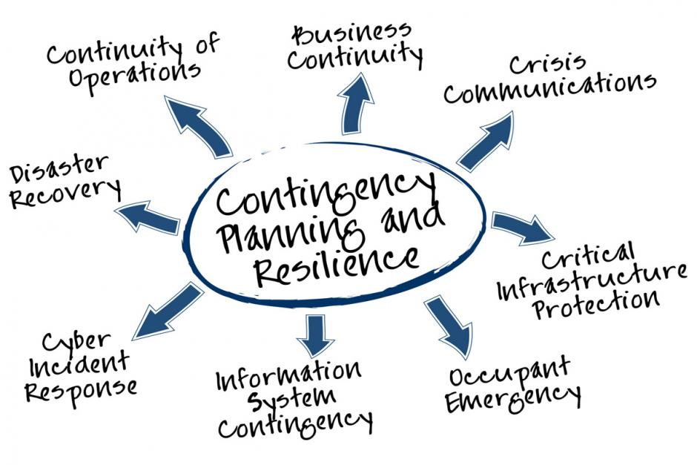
When a Disaster Strikes…
100%
fail for one reason…
  Lack of Preparation

Slide 8

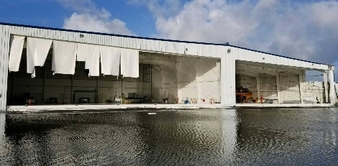
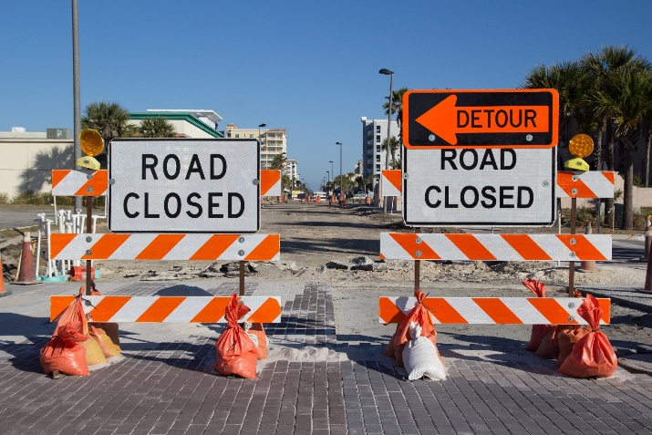
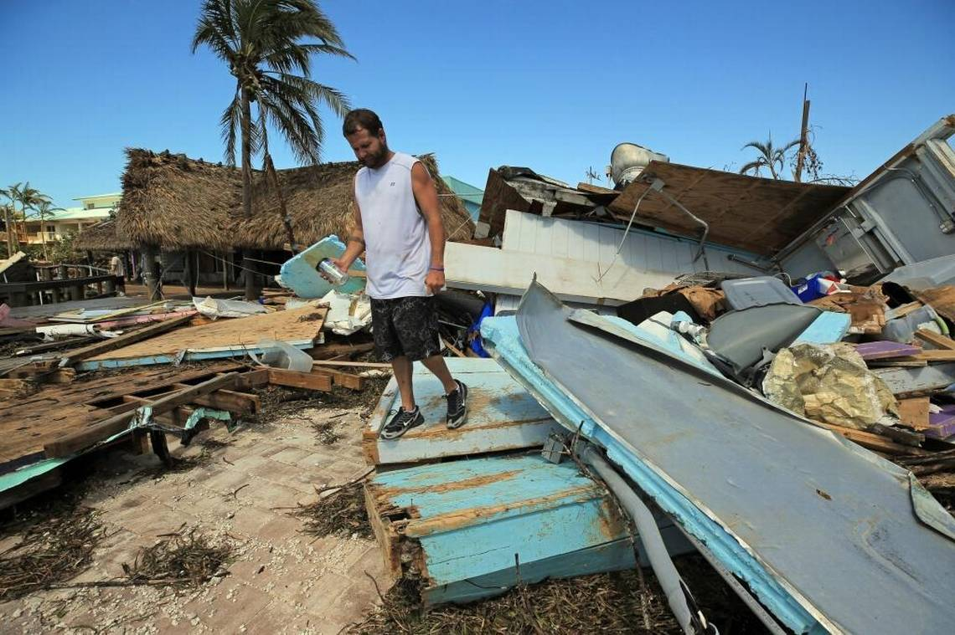
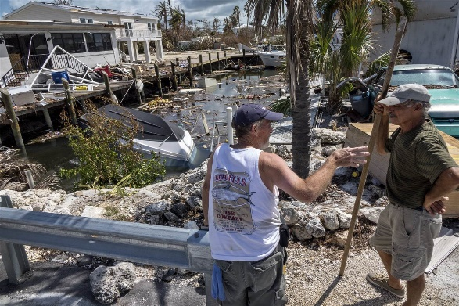
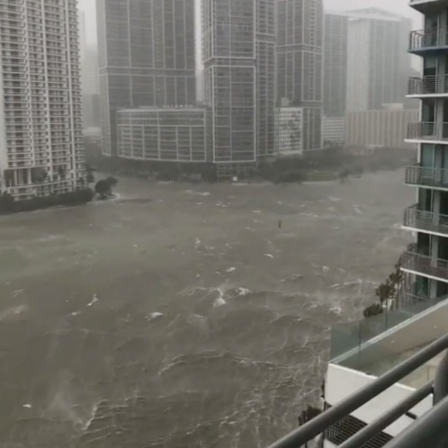
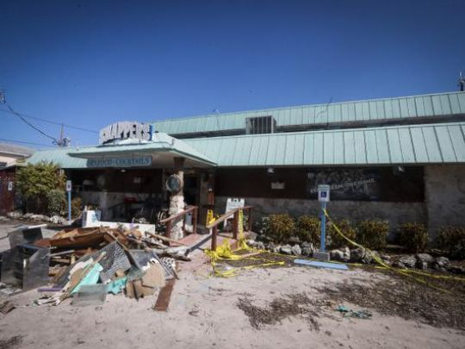
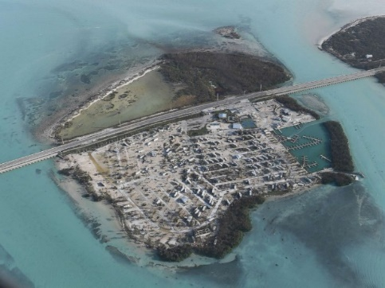
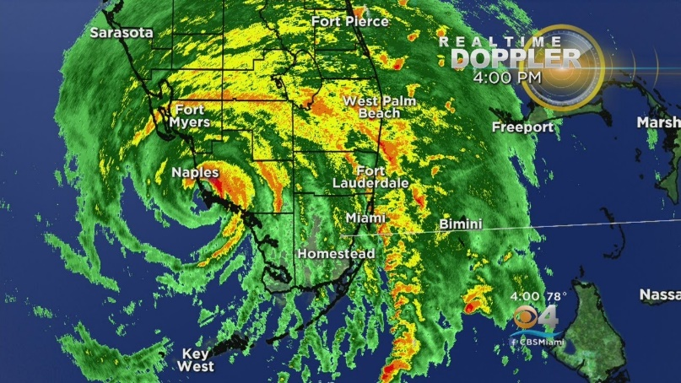
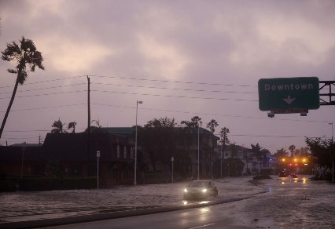
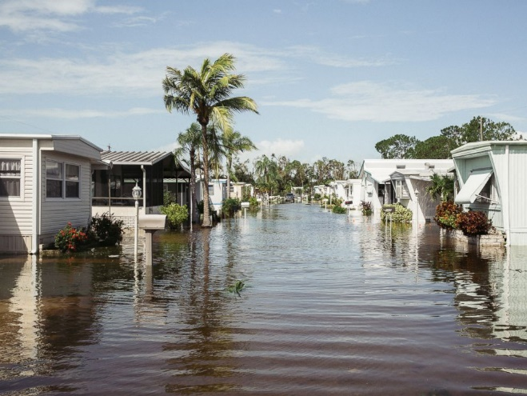
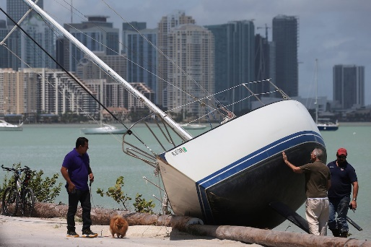
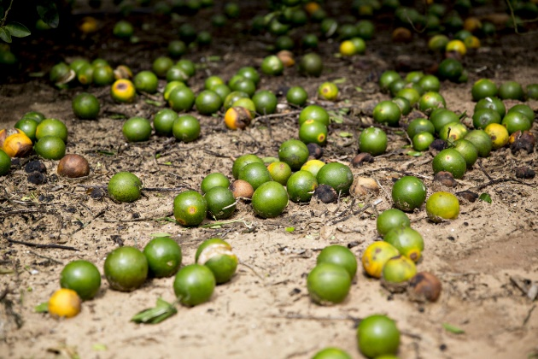
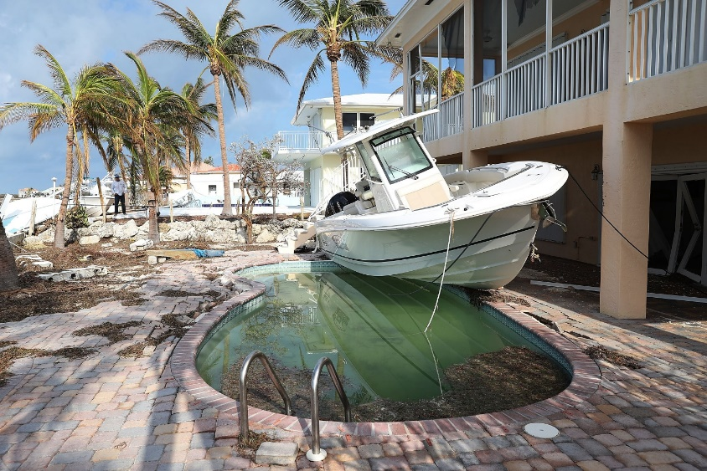
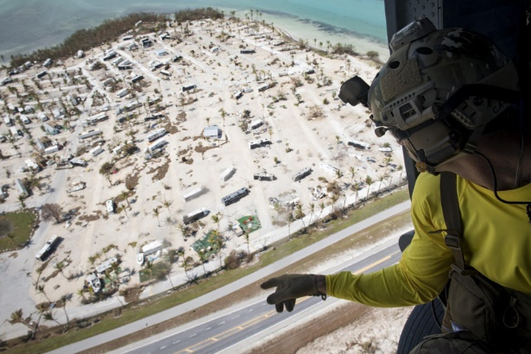
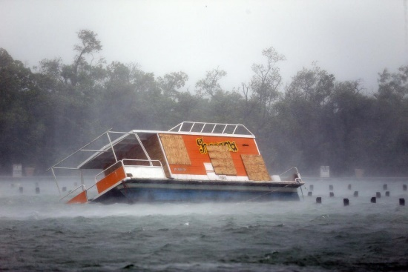
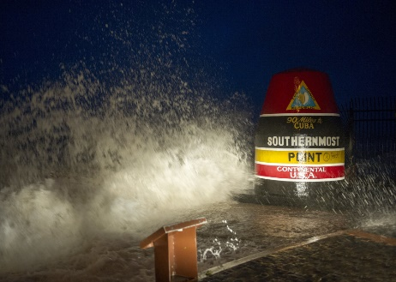
Hurricanes & Tropical Storms

Slide 9
Types of Disasters
Natural Disasters
Man-Made Disasters
Agricultural diseases & pests
Damaging Winds
Drought and water shortage
Emergency diseases
  pandemic influenza, zika
Floods and flash floods
Hurricanes and tropical storms
Landslides & debris flow
Sinkholes
Thunderstorms and lighting
Tornadoes
Wildfire
Hazardous materials
Power service disruption & blackout
Nuclear power plant and nuclear blast
Radiological emergencies
Chemical threat and biological weapons
Cyber attacks
Explosion

Slide 10
Impact of a Disaster on Small Business
FEMA estimates that almost 40% of small businesses that close after a disaster never reopen their doors because just a few inches of water can cause tens of thousands of dollars in damage.
Insurance Institute for Business & Home Safety (IBHS) and U.S. Small Business Administration (SBA) estimate that while one in four businesses can expect to experience a disruptive disaster, approximately 60% of those businesses do not have a basic emergency response plan.
Without a plan, IBHS and SBA estimate that 75% of the impacted businesses will fail within three years of the incident.

Slide 11
Is Your Business Ready?
Whether the disaster is a simple power outage, road construction, flooding, or a more large-scale incident, it will impact your daily operations and jeopardize the future of your entire business.

Slide 12
5 R’s of Disaster
Readiness
  Focuses on understanding how a disaster might impact when it occurs.
Response
  Address the immediate threat presented by an imminent disaster.
Recovery
  Ability to return business to operating status quickly.
Rebuild
  Purposeful strategic planning and action that restores pre-disaster profitability and fosters growth.
Resiliency
  Involves steps to reduce vulnerability to disaster impacts through continuity planning.

Slide 13
Readiness: Begins With a Plan
Does your business have a Business Continuity Plan?
Readiness is your business's ability to respond and continue essential operations following a continuity event.
Disasters can cost businesses a great deal in lost productivity, decreased customer confidence, and decreased finances. According to the Institute for Business and Home Safety, incidents like this could cost small businesses about $3,000 per day.
Almost 2/3 of businesses (62%) responded that they do not have an emergency plan on the books for their business (Ad Council survey)

Slide 14
Continuity Plan: Why?
Business Continuity Planning Is Good for Business
Can be a competitive advantage over competition.
Insurance is only a partial solution.
  Insurance cannot replace lost customers, nor can it cover all losses.
Any significant delays could result in the loss of a customer to a competitor.
Large customers (big business and government) need to know that preparedness is important to their suppliers.

Slide 15
Continuity Planning: Employees
Your Front Line is Your Bottom Line
Can your business function without your most important asset?
Maintain current employee contact information
Have up-to-date emergency contacts
Alternate means of communication
Identify special skills, certifications, etc.
First aid, CPR, or military training
Help employees with personal disaster plans

Slide 16
Continuity Planning: Vendors
Suppliers Can Make or Break You
Can your business function without your suppliers and vendors?
Maintain current vendor information
Primary and alternate contacts
Have alternate supplier(s)
Do your most important suppliers have a continuity plan – Ask
  If they don’t, how could that affect you?
Don’t forget your banker and accountant!

Slide 17
Continuity Planning: Customers
Without Them, Does It Matter
Can your business survive without customers?
Identify the likelihood that customers will be present in your business if a disaster occurs.
Keep communications open with customers
  (phones, email, website, social media)
Monitor the Internet and social media to track trending stories.
Keep a copy of your customer records off-site or in the cloud.
Have an alternate worksite from which to communicate to customers during recovery.

Slide 18
Continuity Planning – Example
Business Drive-Away Kit: What’s That?
Vital, mission critical records, standard operating procedures, operating orders or regulations, etc. that is not already pre-positioned at the Emergency Relocation Site including, but not limited to, the following:
  Current Emergency Notification / Key Personnel Lists
  POC, Fax, Telephone and E-Mail Contact Lists
    Vendors, Suppliers, Accountant, Banker and Key Customers
  Important Database Backup Media
    Identify records vital to perform critical functions
    Make multiple copies of vital records
    Store a copy on-site & off-site
    Utilize multiple media formats
    Regularly back-up vital records and data
    Date back-ups or identify new version(s)
    Test back-up systems
    Maintain photographic records of inventory, furnishings, fixtures, equipment – important for insurance and SBA.

Slide 19
Planning is an Ongoing Process,
Not a One-Time Event
Do not procrastinate
Conduct tabletop exercises
Involve key personnel in the organization
Update your plan regularly and test it repeatedly
Get help from professionals (SBDC)

Slide 20
Basics to a Smooth(er) Recovery
Document Your Damage/Impact
Call your Insurance Agent
Contact your local SBDC
Communicate with Your Customers, Suppliers, and Employees
File a Tax Extension (if applicable)
Avoid Contractor Fraud/Scams

Slide 21
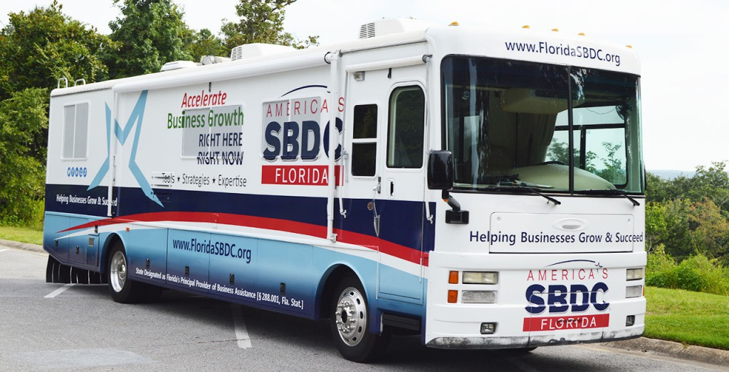
Before, during and after a disaster, we are there to help protect your small business.
FloridaSBDC.org

Slide 22
Planning Resources
U.S. Small Business Administration
www.sba.gov/business-guide/manage-your-business/prepare-emergencies
Florida Department of Economic Opportunity
www.FloridaDisaster.biz
Florida Small Business Development Center
www.FloridaSBDC.org

Slide 23
Questions?
Q&A

Slide 24
Thank you
Contact us
386-506-4723
www.FloridaSBDC.org

